Slide 1
Project Life Cycle
Defining
Planning
Executing
Controlling
Closing

Slide 2
Project Life Cycle : Defining
Problem or opportunity being addressed
Goal of the project
Objectives needed to accomplish the goal
Criterion of determining success
Assumptions or Risks identified

Slide 3
Project Life Cycle : Planning
Roadmap of the how the work will be done
What to do?
Why to do?
When to do?
What resources are needed?
Benefits of Planning
Reduces Uncertainty
Increases Understanding
Improves Efficiency

Slide 4
Project Life Cycle : Executing
(Referred to as Organizing)
Organizing People
Identification of Specific resources
Scheduling workers to activities
Scheduling activities

Slide 5
Project Life Cycle : Controlling
Monitor project progress and slips
Look ahead for potential problems
Handle Change

Slide 6
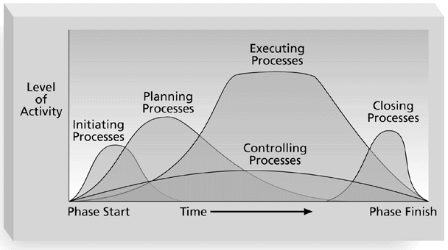

Slide 7
Project Life Cycle : Closing
Did the project do what the requestor said it would do?
Did the project do as specified by the project manager?
Was the project completed according to plan?
What helpful information was collected?
How well the project plan was followed?

Slide 8
Software metrics and Estimation

Slide 9
Techniques for estimation
We measure
  Size
  Effort
  Cost

Slide 10
Techniques for estimation
Function point based
LOC based
COCOMO

Slide 11
We measure to
To indicate the quality of the product
To assess the productivity of the people who produce the product
To assess the benefits derived from new software engineering methods and tools
To form a baseline for estimation
To help justify requests for new tools or additional training

Slide 12
The Challenge of Metrics
A comprehensive measure of software complexity is an impossible goal
Consider a measure for evaluating an attractive car

Slide 13
Important Concepts
Measure (noun or verb)
  a quantitative indication of an attribute of a product or process; like capacity, size, quality
  Examples: errors, quality of software, correctness
Metrics
  Quantitative measure of the degree to posses a given attribute
  Examples, Number of errors, errors per person
Measurement
  The act of measuring

Slide 14
Metrics Guidelines
Use common sense and organizational sensitivity when interpreting metrics data
Provide regular feedback to the individuals and teams who have worked to collect measures and metrics
Don’t use metrics to appraise individuals
Never use metrics to threaten individuals or teams
Don’t obsess on a single metric to the exclusion of other important metrics

Slide 15
Types of Metrics
In direct measures
  Quality, functionality, complexity, reliability, efficiency, maintainability, …
Direct measures
  Lines of codes (LOC), speed, cost, memory size, errors, ...

Slide 16
Techniques
Function point estimation
LOC based estimation
COCOMO

